Slide 1

Shane Dalton (PO)
Sydney Flak
Kyle Batross
Milkhais Haile (SM)
Tingting Wang
Notes:
Shane does the cheesy intro

Slide 2

Product Description
The product is an online platform for facilitating the exchange of goods. Users can place bids on other peoples goods using items from their own personal inventory.
Notes:
Kyle describes product

Slide 3
High Level Goals
Upload items to exchange with others
Publish a listing, allowing others to view and bid on a user’s good
Set up and modify a profile
Filter and search for listings based on user’s preference
Use items from user inventory to bid on other goods
Communication feature between sellers and bidders
Notifications to update users on listing activity
Notes:
kyle

Slide 4
Sprint 1
As a developer, I want to learn the technologies involved in this project
As a user, I want to login/out of my account
As a user, I want to add / edit items to my inventory
As a user, I want to be able to create a listing
Notes:
Tingting

Slide 5
Sprint 2
As a bidder, I want to be able to bid on an item
As a user I want to be able to view listings on the website
As a user, I want to be able to search and filter items of my preference
As a seller, I want to be able to choose the winning bid
Notes:
Tingting

Slide 6
Sprint 3
As a user, I want to receive relevant notifications via emails/my dashboard
As a bidder/seller, I want to be able to chat with potential buyer/seller
As a user, I want to be able to modify my profile

Slide 7
Sprint 4
As a user, I want to be able to view popular items for bidding
As a system provider, I want listing to be returned to user inventory after 7 days
As a QA technician, I want the user to be able to browse the app with no bugs

Slide 8
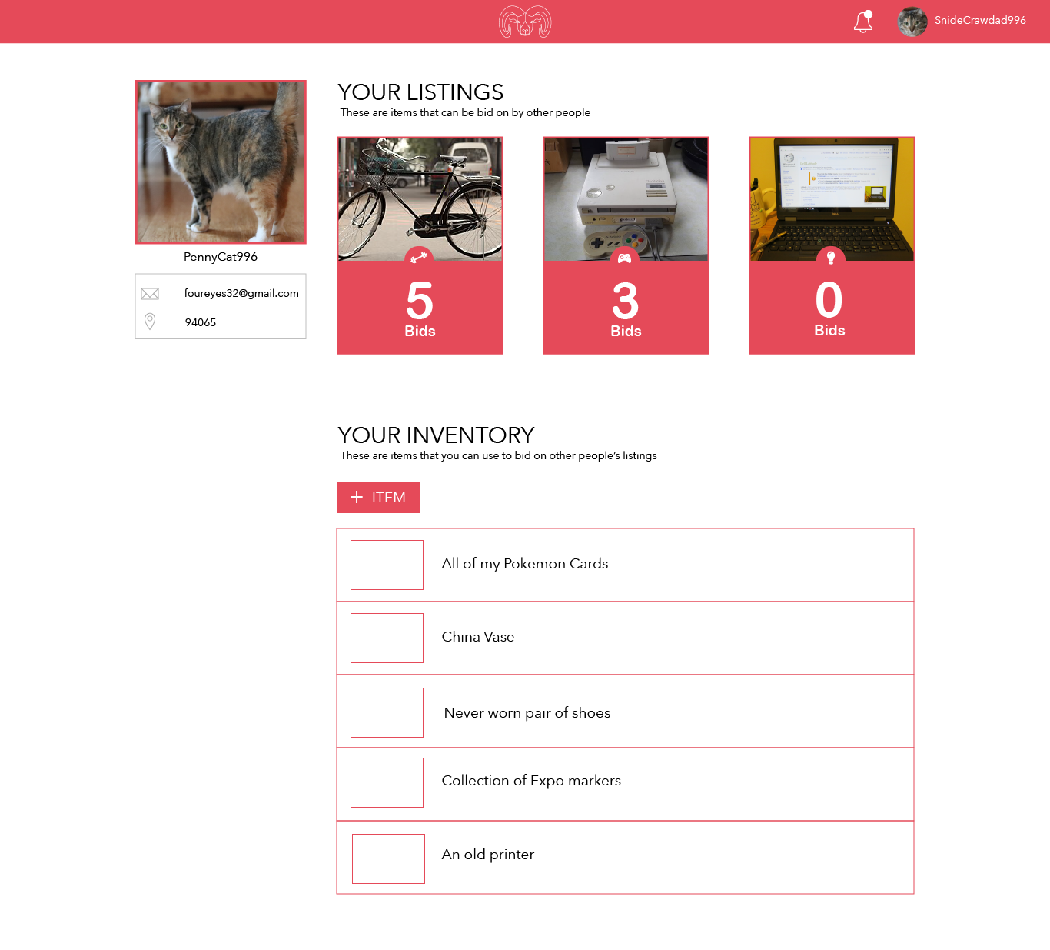




Structure
Notes:
Sydney Explains

Slide 9
Challenges
Everyone is inexperienced with React
A chat system is a complicated feature
Being overly ambitious with the project
Making the application usable on multiple platforms
Members are inexperienced with backend
Notes:
Milky

Slide 10




Technology
Group Management
Development
Slack for team communication
GitHub for version control
Google Drive for team documents
React for front end application
Trello for SCRUM board
Firebase for back-end
Webpack for cross-browser support
Notes:
Milky

